Slide 1


ADC Resolution vs Sensor Less Motor Control Performance
Cristian Ornelas, Tyler Hawkins, Tamara Basfar, John Adam King
Sponsor: Texas Instruments (Han Zhang, Kevin Allen)

Slide 2
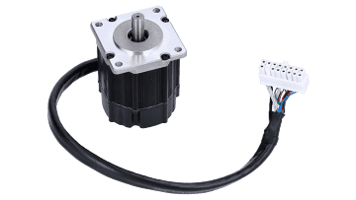
Problem Statement
Conventional motor systems usually depend on sensored motor control to supply feedback, but these sensors can malfunction, particularly in unfavorable environments. There is an increasing need to simplify systems, improve dependability, and decrease cost expenses. On the other hand, with sensorless motor control, the drawback is that there is a lack of feedback at low speeds during startup.
Solution?
Notes:
Christian
2 minute

Slide 3
Project Description
Solution proposal: Develop software for sensorless motor control on one of TI’s newest c2000 devices with enhanced features, and conduct an array of tests on the software to determine what set of sensorless control parameters are most effective.
Notes:
Case
2 minute

Slide 4
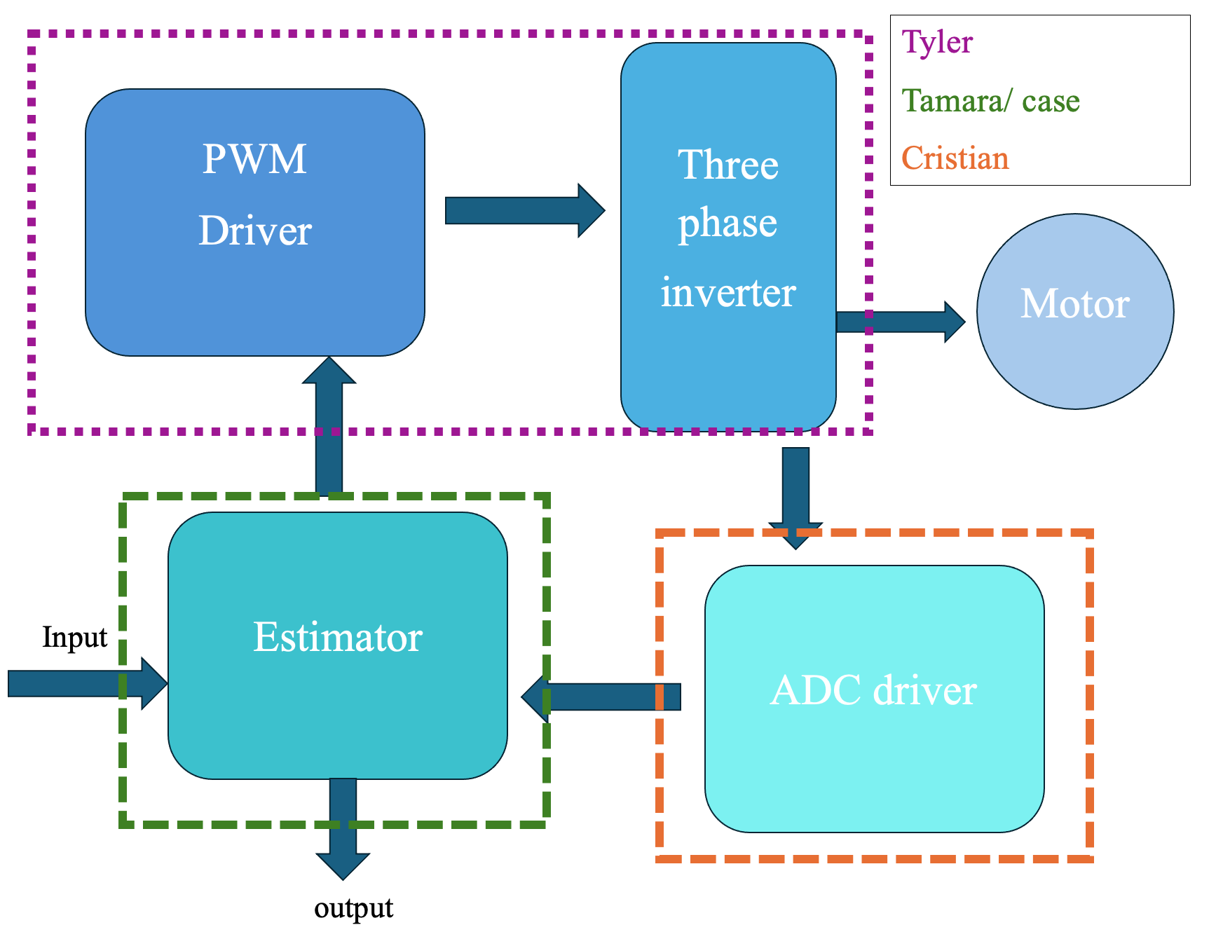
Diagram of subsystems and interface
Notes:
Tyler->Cristian->Case/Tamara

Slide 5
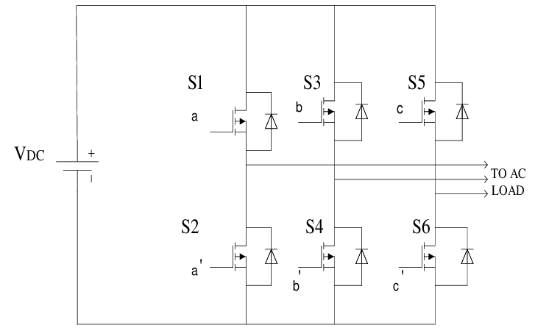
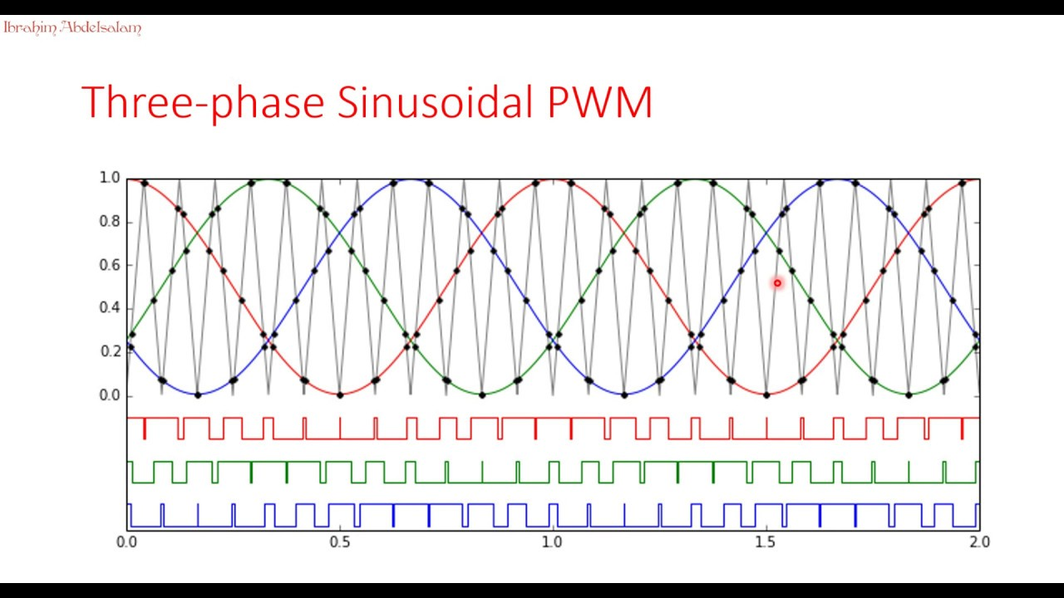
Subsystem 1: PWM Driver & 3-Phase Inverter
A 3 phase Inverter opens & closes switches in pairs to convert the DC voltage into very blocky 3 phase signals
Pairs: 1&4, 1&6, 3&6, 3&2, 5&2, 5&4
PWM (Pulse Width Modulation) is used to rapidly open and close the switches to vary the output frequency of voltage, to create the 3-phase AC Voltage supply.
Notes:
Tyler
1 minute

Slide 6
Subsystem 2: Estimator
Tamara / Case
Required Information:
The Rotation of the motor generates a voltage in the motor windings called the Counter-electromotive force or Back EMF.
The Back EMF is calculated using a shunt resistor and the measured current to determine the voltage difference.
Estimation Equation:
The Back EMF is taken plugged into the equation:
w = Eb / Ke
Where w is the angular velocity, Eb is the back EMF, and Ke is the back EMF constant.
Output Information:
Taking the angular velocity of the motor and time spent at that speed, the system determines its position and outputs to the motor controller.
Notes:
Case
1 minute

Slide 7
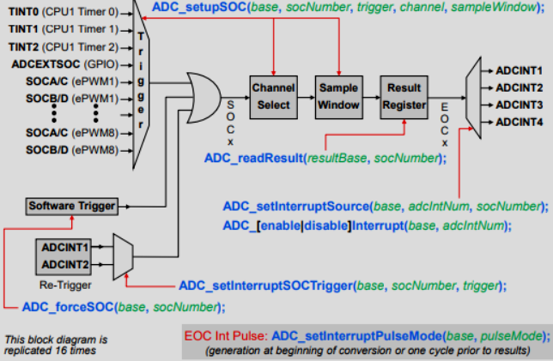
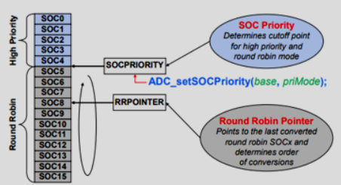
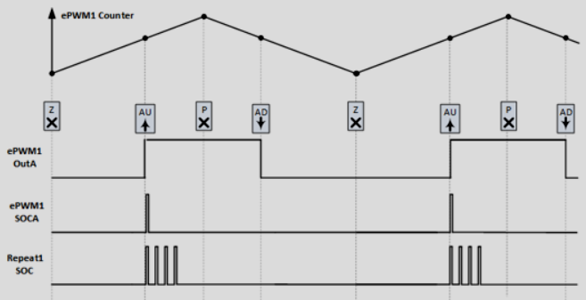
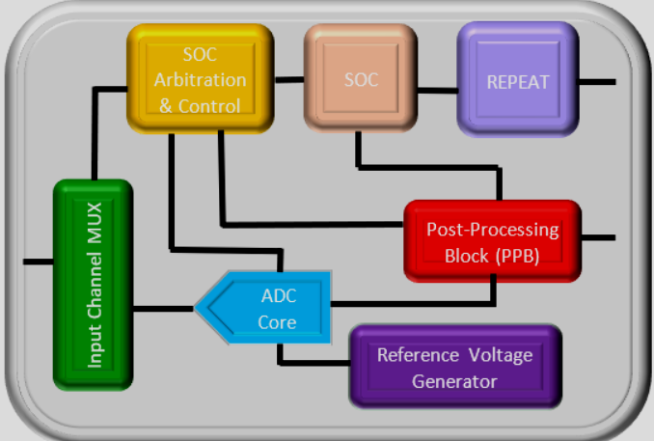
Subsystem 3: ADC Driver
The C2000 ADC Driver System enables analog-to digital conversion: 12-bit and 16-bit modes.
Start of Conversion (SOC):
-SOC registers control how and when the ADC converts signals.
- Trigger sources such as a timer starts the conversion. -The channel selection specifies which analog input pin will be converted by the ADC.
- Acquisition Sample Window: This window determines how long the ADC will sample the input signal before conversion.
ADC Conversion Priority:
Round Robin is the default mode where all the conversions take turns with with no specific order of priority.
Trigger Modifications:
Oversampling:To achieve a more accurate average value, the same signal can be sampled multiple times.
Undersampling: When continuous data is not necessarily needed, the signal can be sampled less frequently.
Phase delay: The trigger can be elated to avoid capturing noisy data.
Safety Features:
The ADC driver has a built in safety features that compare results from different ADC result registers. If the difference happens to be too large, it can trigger an interrupt, which will alert the system.
Notes:
Christian
1 minute

Slide 8
Progress In Past 1.5 months
Installed necessary software
Went through TI’s CCS intro Academy
Finalized parts needed and received them
Intro project using code composer studio
Downloaded motor control software development kit
Dissecting sensored control code and learning how to implement sensorless control on new c2000 launchpad
Notes:
Tamara

Slide 9
Why were parts selected?
Part | rationale
F28P65x Board | Newest c2000 device lowest cost for features included
DRV8300 Driver Board | A similar motor control solution has never been implemented on it higher pwm frequencies
Low Voltage Encoder Motor | sensor less control can be implemented and verified when compared to control with the encoder sensor
F28002x Board | Used with a complete solution used to compare performance
DRV8323 Driver Board | Used with a complete solution used to compare performance
Notes:
Tamara

Slide 10
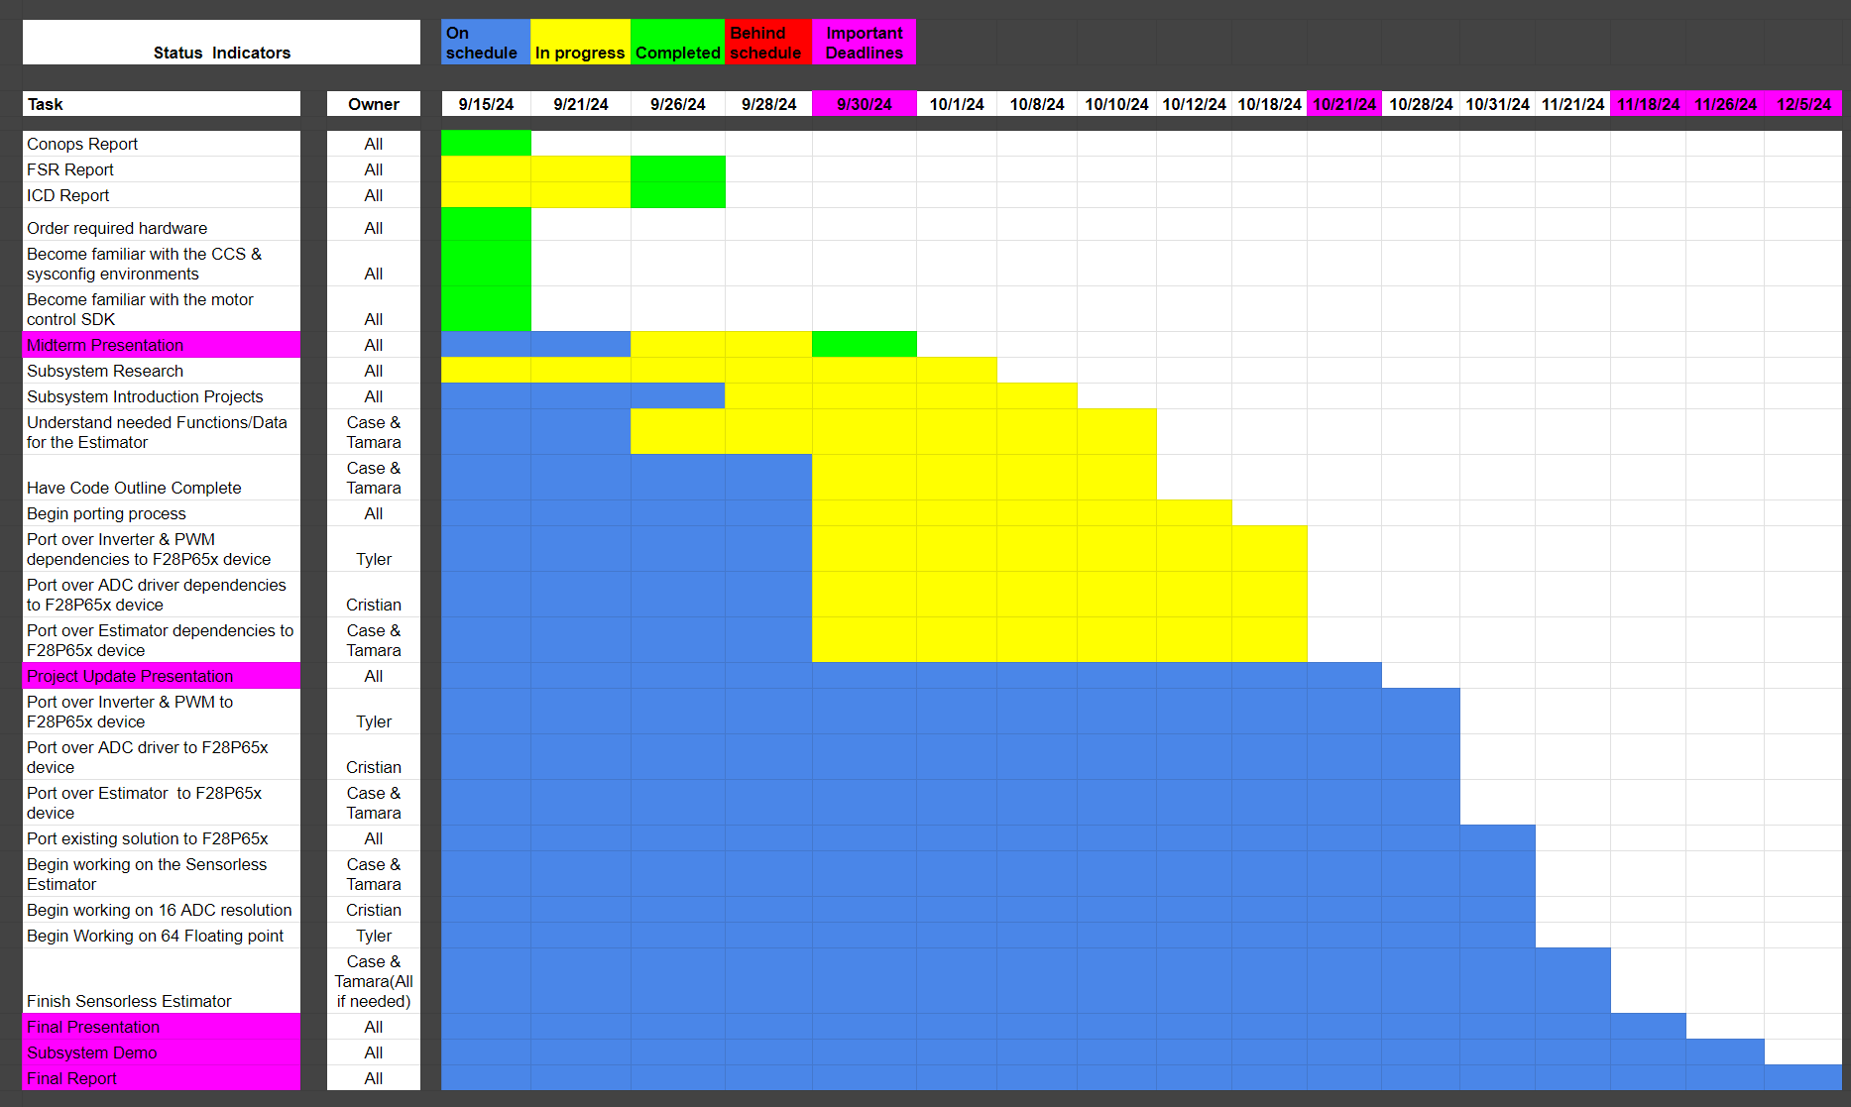
Execution plan
Notes:
Tyler

Slide 11
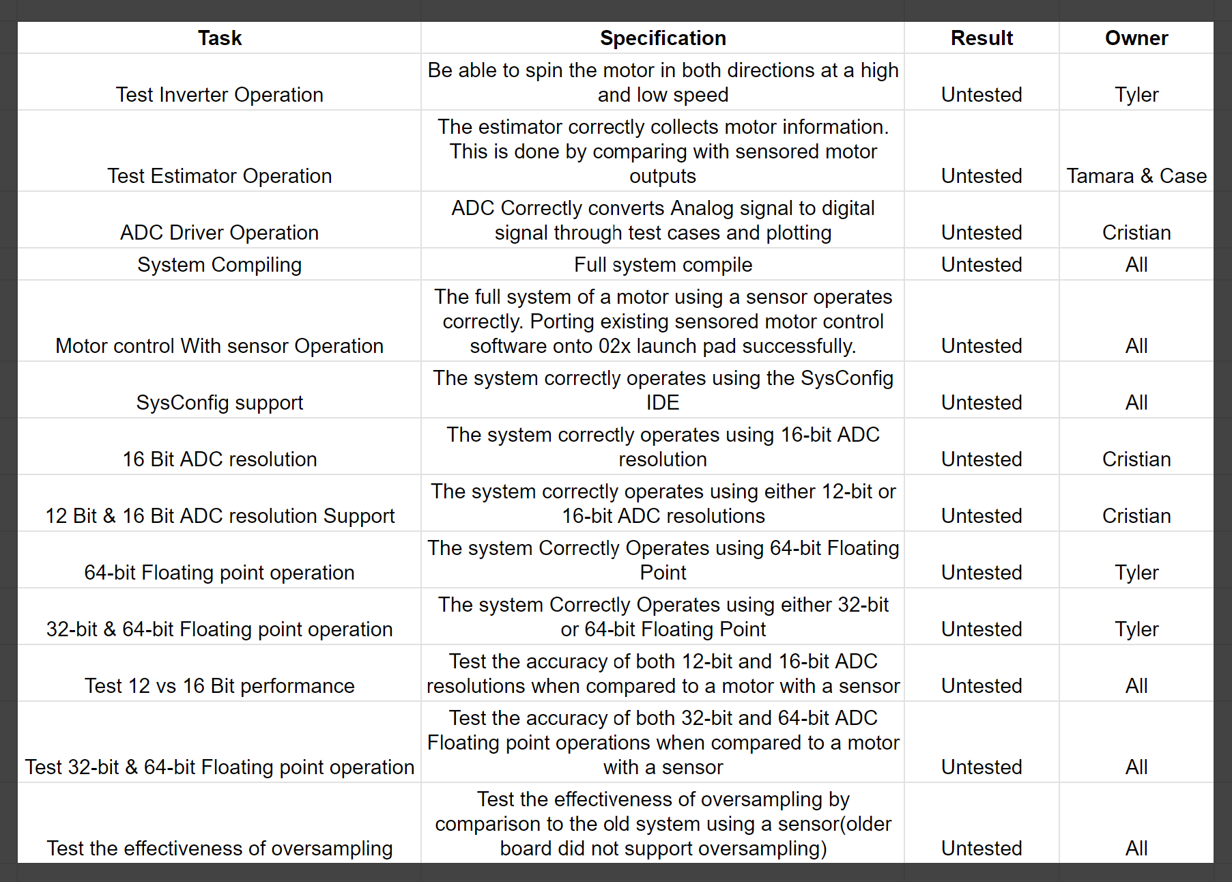
Validation plan
Notes:
Tyler

